Slide 1
Lecture 3
Homogeneous Transformations and Forward Kinematics

Slide 2
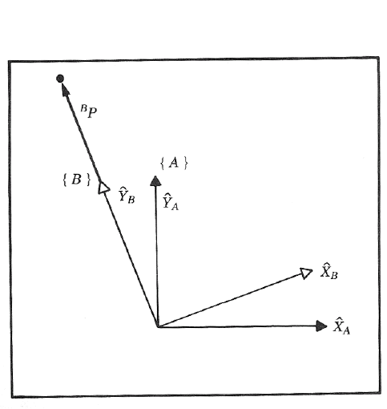
Mapping – Rotating Frames Example

Slide 3
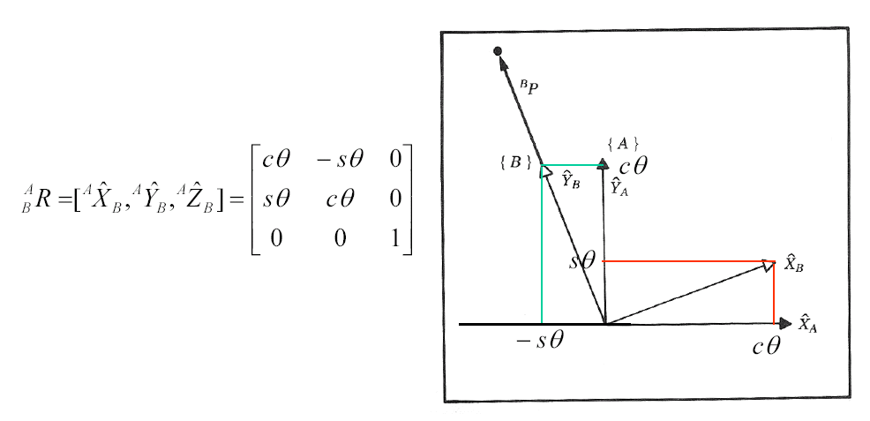
Mapping – Rotating Frames Example

Slide 4
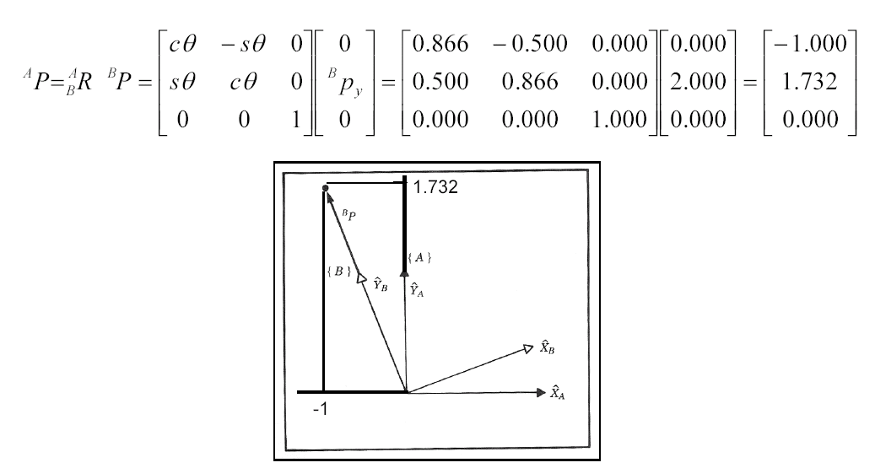
Mapping – Rotating Frames Example

Slide 5
Mapping – Rotated Frames – General Notation
The rotation matrices with respect to the reference frame are defined as follows:

Slide 6
Mapping - Rotated Frames - Methods
X-Y-Z Fixed Angles
The rotations performed about an axis of a fixed reference frame
Z-Y-X Euler Angles
The rotations performed about an axis of a moving reference frame

Slide 7
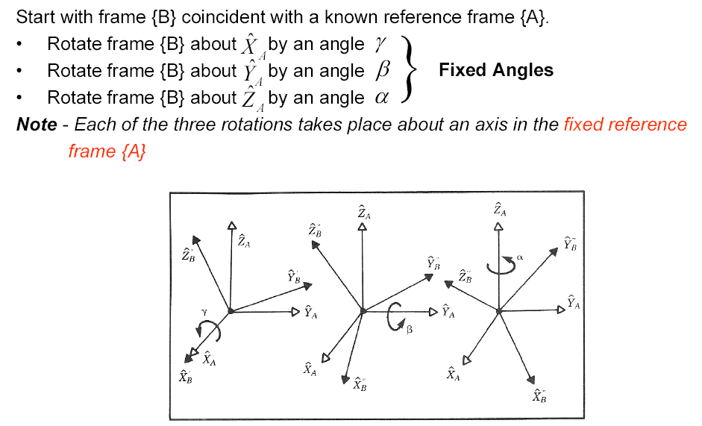
Mapping - Rotated Frames – X-Y-Z Fixed Angles

Slide 8
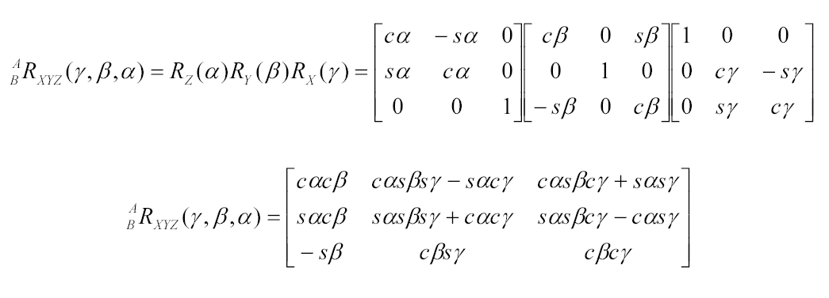
Mapping - Rotated Frames – X-Y-Z Fixed Angles

Slide 9
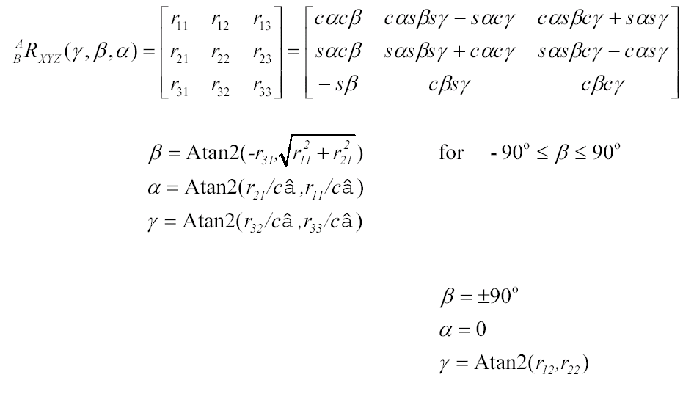
Mapping - Rotated Frames – X-Y-Z Fixed Angles

Slide 10
Atan2 - Definition
Four-quadrant inverse tangent (arctangent) in the range of
For example

Slide 11
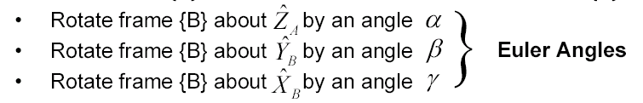
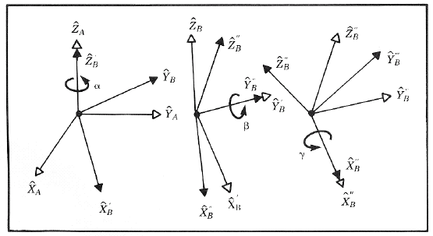
Mapping - Rotated Frames – Z-Y-X Euler Angles
Start with frame {B} coincident with a known reference frame {A}.
Note - Each rotation is performed about an axis of the moving reference frame {B}, rather then a fixed reference frame {A}.

Slide 12
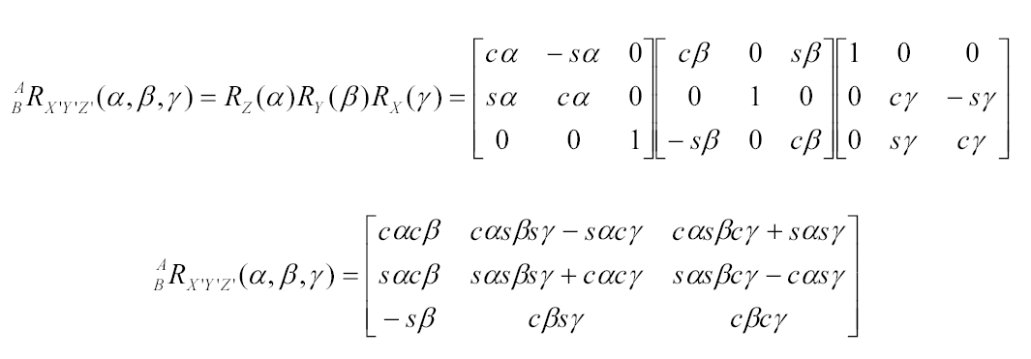
Mapping - Rotated Frames – Z-Y-X Euler Angles

Slide 13
Mapping - Rotated Frames
Fixed Angles Versus Euler Angles
Three rotations taken about fixed axes (Fixed Angles) yield the same final orientation as the same three rotations taken in an opposite order about the axes of the moving frame (Euler Angles)

Slide 14
Operator - Rotating Vector
Rotational Operator - Operates on a vector ^{A}P₁ and changes that vector to a new vector ^{B}P₁, by means of a rotation R
Note: The rotation matrix which rotates vectors through the same rotation R , is the same as the rotation which describes a frame rotated by R relative to the reference frame

Slide 15
Operator - Rotating Vector Example

Slide 16
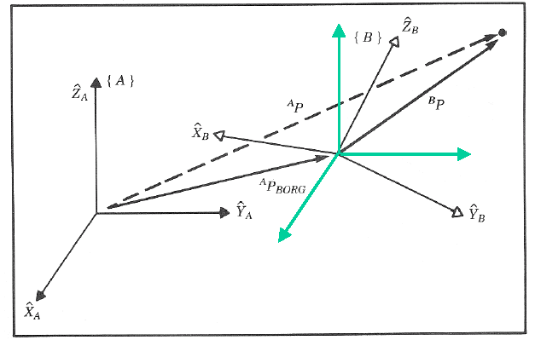
Mapping – General Frames
Assuming that frame {B} is both translated and rotated with respect frame {A},
The position of the point expressed in frame {B} can be expressed in frame {A} as follows

Slide 17
Mapping – Homogeneous Transform
The homogeneous transform is a 4x4 matrix casting the rotation and translation of a general transform into a single matrix
In other fields of study it can be used to compute perspective and scaling operations when the last row is other than [0001] or the rotation matrix is not orthonormal.

Slide 18
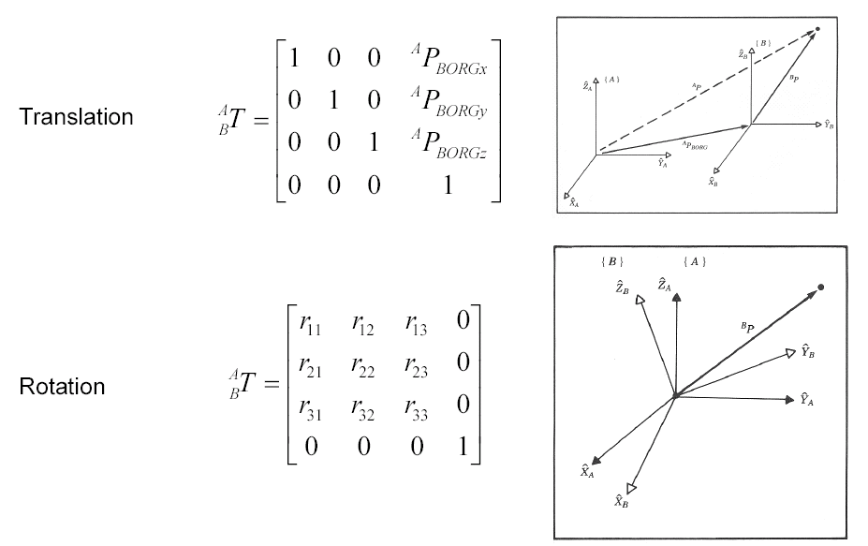
Homogeneous Transform – Special Cases

Slide 19
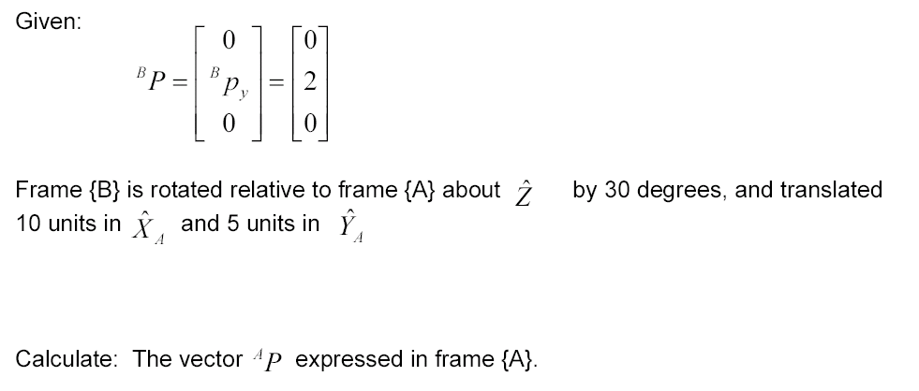
Homogeneous Transform Example
3.0
7.0
0.0

Slide 20
Homogeneous Transform Example

Slide 21
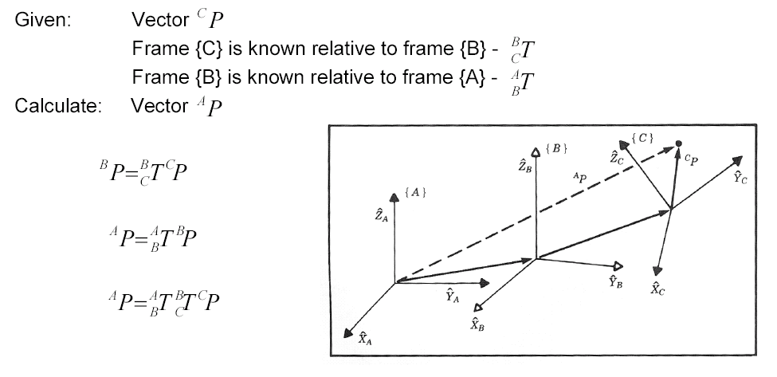
Transformation Arithmetic - Compound Transformations

Slide 22
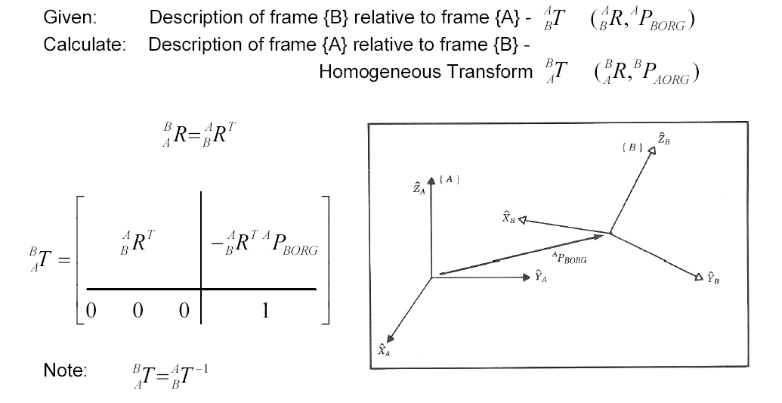
Transformation Arithmetic – Inverted Transformation

Slide 23
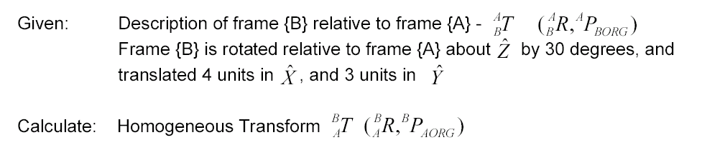
Inverted Transformation Example

Slide 24
Inverted Transformation Example

Slide 25
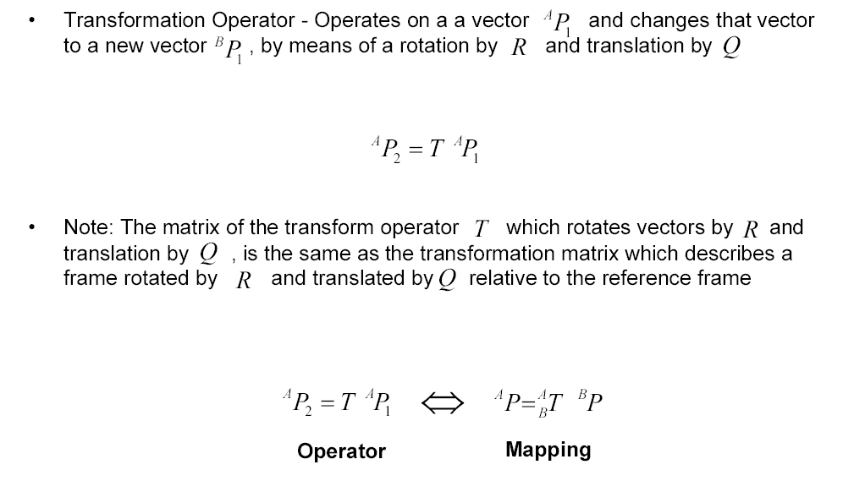
Operator – Transforming Vector

Slide 26
Homogeneous Transform - Summary of Interpretation
As a general tool to represent a frame we have introduced the homogeneous transformation, a 4x4 matrix containing orientation and position information.
Three interpretations of the homogeneous transformation:

Slide 28
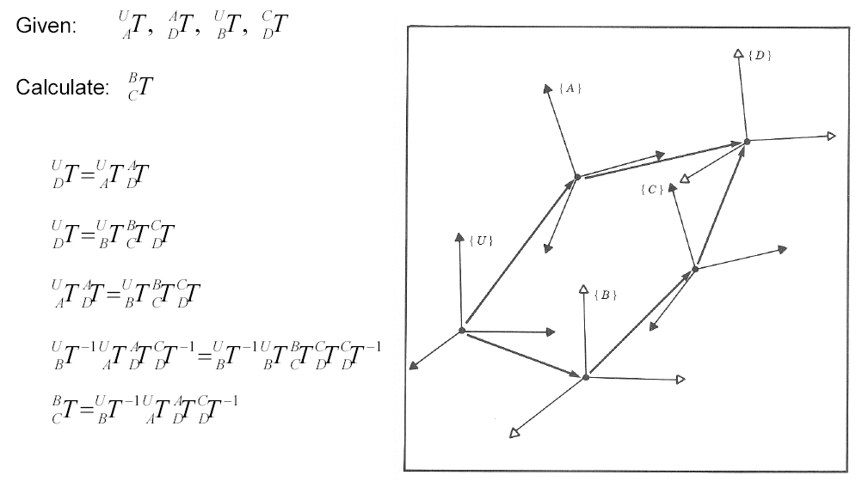
Transform Equations

Slide 29
Kinematics - Introduction
Kinematics - the science of motion which treat motions without regard to the forces that cause them
e.g. position, velocity, acceleration, higher derivatives of the position
Kinematics of Manipulators - All the geometrical and time based properties of the motion

Slide 30
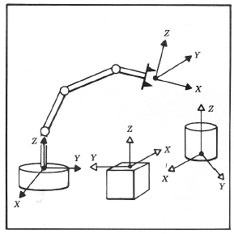
Central Topic
Problem
Given: The manipulator geometrical parameters
Specify: The position and orientation of manipulator
Solution
Coordinate system or “Frames” are attached to the manipulator and objects in the environment following the Denenvit-Hartenberg notation.

Slide 31
DH parameters
There are a large number of ways that homogeneous transforms can encode the kinematics of a manipulator
We will sacrifice some of this flexibility for a more systematic approach: DH (Denavit-Hartenberg) parameters.
DH parameters is a standard for describing a series of transforms for arbitrary mechanisms.

Slide 32
Forward kinematics: DH parameters
These four DH parameters,
represent the following homogeneous matrix:
First, translate by along z axis
Then, translate by along x axis
and rotate by about z axis
and rotate by about x axis

Slide 33
Forward kinematics: DH parameters

Slide 34
Forward kinematics: DH parameters
Four DH parameters:
First, translate by along z axis
Then, translate by along x axis
and rotate by about z axis
and rotate by about x axis

Slide 35
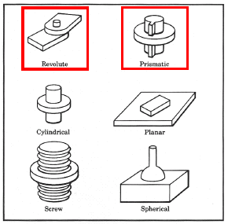
Joint/Link Description
Lower pair - The connection between a pair of bodies when the relative motion is characterize by two surfaces sliding over one another.
Mechanical Design Constraints
1 DOF Joint
Revolute Joint
Prismatic Joint
Link - A rigid body which defines the relationship between two neighboring joint axes of the manipulator

Slide 36
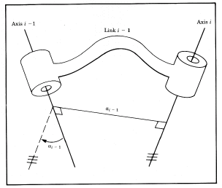
Link Parameters (Denevit-Hartenberg) – Length & Twist)
Joint Axis - A line in space (or a vector direction) about which link i rotates relative to link i-1
Link Length – a_{i-1}
The distance between axis i and axis i-1
Notes:
Expanding cylinder analogy
Distance
Parallel axes → ∞
Non-Parallel axes → 1
Sign → a_{i-1} ≥ 0
Link Twist – α_{i-1}
The angle measured from axis i-1 to axis i
Note : Sign α_{i-1} by right hand rule
Notes:
Expanding cylinder whose axis is the joint i-1 axis, when it just touches joint axis I the radius of the cylinder is a_i-1

Slide 37
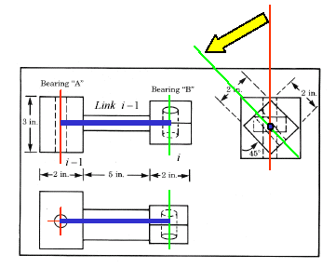
Link Parameters - Example
Axes
Link Length → a_{i-1} = 7 in
Link Twist → a_{i-1} = 45°

Slide 38
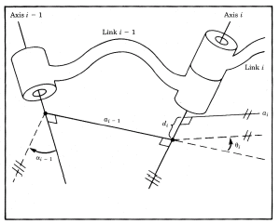
Joint Variables (Denevit-Hartenberg) – Angle & Offset
Link Offset – d_{i}
The signed distance measured along the axis of joint i from the point where a_{i-1} intersects the axis to the point where a_{i} intersects the axis
The link offset d_{i} is variable if joint i is prismatic
Sign of d_{i}
Joint Angle – θ_{i}
The signed angle made between an extension of a_{i-1} and a_{i} measured about the the axis of the joint i
Note:
The joint angle θ_{i} is variable if the joint i is revolute
Sign - θ_{i} → Right hand rule

Slide 39
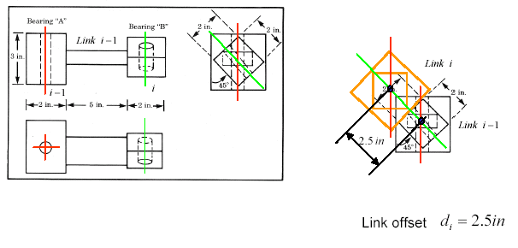
Link Parameters - Example

Slide 40
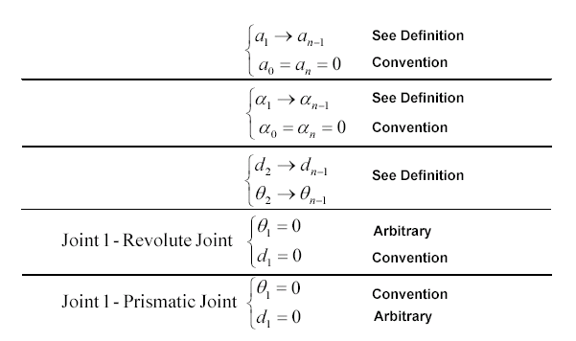
Joint/Link Parameters & Values – First and last links in chain

Slide 41
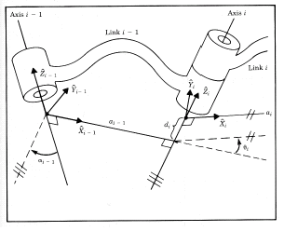
Affixing Frames to Links – Intermediate Links in the Chain
Origin of Frame {i} –
The origin of frame {i} is located where the a_{i} perpendicular intersects the joint i axis
Z Axis -
The axis of frame {i} is coincident with the joint axis I
X Axis -
The axis points along the distance a_{i} in the direction from joint i to joint i+1
Note:
For a_{i} = 0, is normal to the plane of and
The link twist angle α_{i} is measured in a right hand sense about
Y Axis-
The axis completes frame {i} following the right hand rule

Slide 42
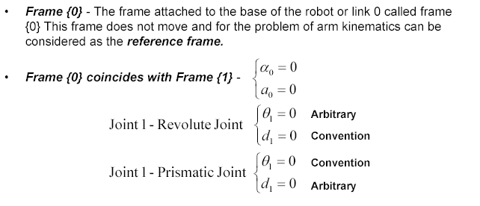
Affixing Frames to Links – First & Last Links in the Chain

Slide 43
Link Frame Attachment Procedure - Summary
Identify the joint axes and imagine (or draw) infinite lines along them. For step 2 through step 5 below, consider two of these neighboring lines (at axes i and i+1 )
Identify the common perpendicular between them, or point of intersection. At the point of intersection, or at the point where the common perpendicular meets the i th axis, assign the link frame origin.
Assign the axis pointing along the i th joint axis.
Assign the axis pointing along the common perpendicular, or if the axes intersect, assign to be normal to the plane containing the two axes
Assign the axis to the complete a right hand coordinate system.
Assign {0} to match {1} when the first joint veritable is zero. For {N}, choose an origin location and direction freely, but generally so as to cause as many linkage parameters as possible to be zero

Slide 44
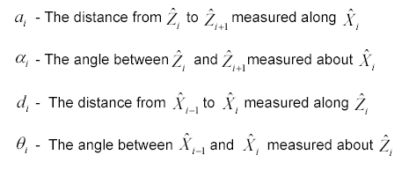
DH Parameters - Summary
If the link frame have been attached to the links according to our convention, the following definitions of the DH parameters are valid:
Note:
a_{i} ≥ 0 , and α_{i} , d_{i} , and θ_{i} are signed quantities

